Slide 1
Demo - tutorial

Slide 2
Goals to achieve
Install MCUXpresso extensions.
Download the SDK.
Flash NBU binary.
Building and flashing the Wireless UART application on the board.
Running the Wireless UART application using NXP IoT Toolbox.

Slide 3
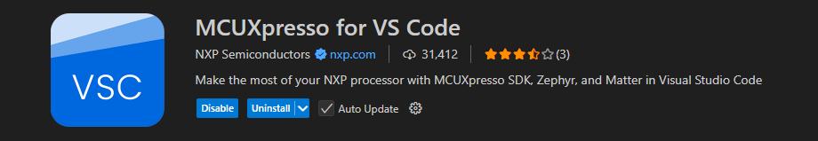

Install MCUXpresso extensions for VS Code
1
2

Slide 4
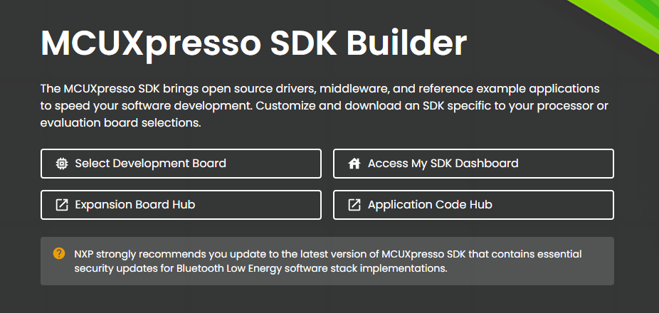
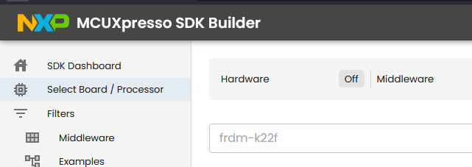
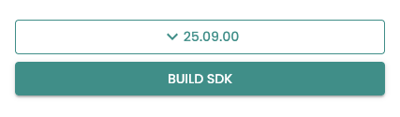
Build and download the SDK
To install the Connectivity Package, configure and download the package archive from the staging system
on the https://mcuxpresso.nxp.com website. You can simply download the precreated package archive if it is
available on the same website.
Select Development Board
Create an account
Finde your board
Build SDK
Select all toolchains and build sdk
Download
1
3
5
4

Slide 5
Flash NBU binary
Go to the GitHub link and download blehost and teraterm.
Path: blhost_2.6.7 1.zip\blhost_2.6.7\bin\win (open cmd here).
Put the board in ISP mode.
The commands are as follows:
.\blhost.exe -p COMx -- get-property 1
.\blhost.exe -p COMx flash-erase-all 2
.\blhost.exe -p COMx flash-erase-region 0x48800000 0x80000
.\blhost.exe -p COMx write-memory 0x48800000 “..\middleware\wireless
\ble_controller\bin” (Ex: “C:\_ddm\mcuxsdk-workspace\mcuxsdk\middleware
\wireless\ble_controller\bin\kw47_nbu_ble_all_hosted.bin")
To put the board in ISP mode, hold down the BOOT CONFIG
button at the moment you power it on.

Slide 6
Building and flashing the BLE Software Demo applications using MCUXpresso IDE
Building the binaries — MCUXpresso SDK Documentation
You have to open the “w_uart” application.

Slide 7

Wireless UART Demo
Bluetooth LE stack and demo applications — MCUXpresso SDK Documentation

Slide 8
IoT Toolbox
Running the Wireless UART application using NXP IoT Toolbox mobile application — MCUXpresso SDK Documentation

